Slide 1
Insights to Olympic Games
SportsStats – Sport Analytics

Slide 2
Olympic Games – Key Insights
We are analysing Olympic dataset to provide interesting trends, patterns about Olympic games to our local news partners and elite personal trainers.
This analysis would help these stakeholders to provide ‘interesting’ insights to their partners and developing a news story or discovering key health insights.

Slide 3
Questions to Answer
How age, weight, height and sex matters in winning medals in different games.
Identify various patterns, trends in winning medals and explore top performing athletes, nations of all the time.
Explore the features that could be important to predict the medal winning in upcoming Olympic games.

Slide 4
Initial Hypothesis
Host nations significantly outperform visiting nations at the Olympic Games.
There are high-performing athletes who won the medals in various game events.
Height and weight has more impact in team sports.

Slide 5
Approach
“Athlete-related”: age, weight, height and sex matters in winning medals in different games
“National-related”: check the medals distribution based on national metric
Check the correlations between different metrics – return the weight of each metric for gaining the medals

Slide 6
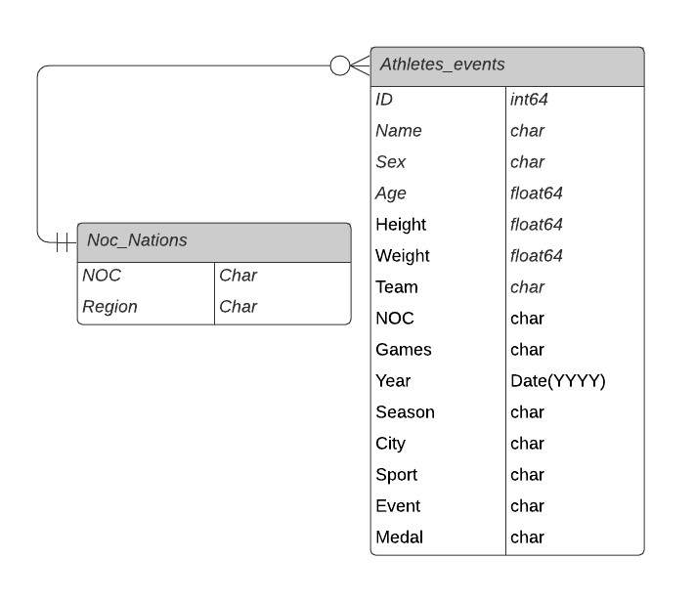
ER-Diagram

Slide 7
Data Exploration

Slide 8
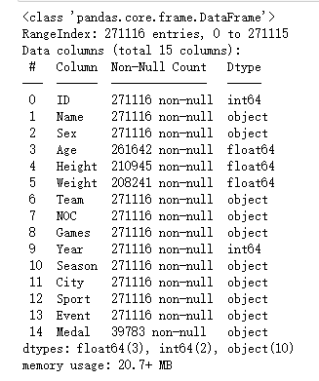
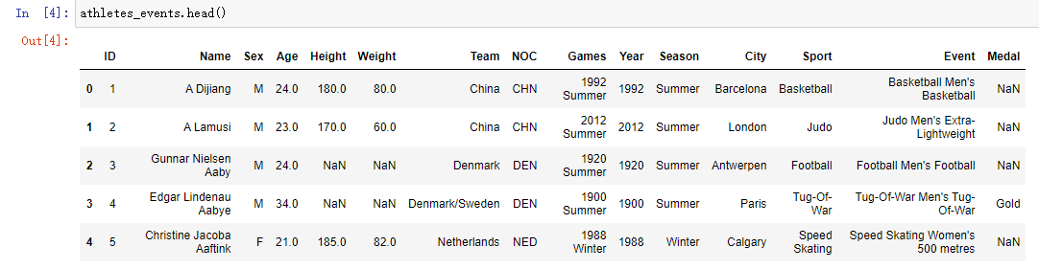
Initial Exploration
We imported Olympic data in Jupyter Notebook using Pandas library.
Quick look at the values in the dataset to understand the various columns and their data types.

Slide 9
Data Analysis
The histograms of the features height, weight and age shows that:
Athletes are having height around 170 inches, weight around 70 kg and age between 20 to 30 years.
Rhythmic gymnastics has an average age of 19 – while for the equestrian events it's 38. But within that there are still some surprises: mountain bike cycling for instance, has an average age of 33 and for beach volleyball it's 29.
Height and weight are dependent on sex. Taking a look at men's heights, the tallest male athlete stands at 2.26m is Chinese basketball player Yao Ming and a close second is 20-year-old US basketball player, Tommy Loren Burleson at 2.23m. The shortest is a 25-year-old Malawi male boxer (Light-Welterweight) standing at 1.27m tall, Lyton Levison Mphande. The tallest female athlete is a basketball player from Poland, Magorzata Teresa "Margo" Dydek (-Twigg) who is 13cm over the 2m mark. The shortest is Mexican Gymnastics Women's Balance Beam player Rosario Briones, standing at just 1.27m.
Weights were a bit trickier in that certain sports (Boxing, Gymnastics, Synchronised swimming, Taekwondo and Trampoline) did not give weights for their athletes. Taking this into account, the heaviest male athlete is Ricardo Blas Jr, a Judo competitor from Guam. The lightest is Choi Myong-Hui (25kg only!!) from North Korea, who is the Gymnastics Women's Balance Beam player. The heaviest woman is an Ukraine weightlifter, Olha Vasylivna Korobka, weighing in at 167kg. The lightest woman is Choi Myong-Hui from North Korea. Weighing just 25kg she competed in the Gymnastics Women's Balance Beam. Croatia – one of the top 3 tallest teams (183.6 cm on avg) – is also one of the heaviest: its average weight is 82kg, just above Serbia. The lightest large team is Colombia's group of 106 athletes at an average of only 64.9kg, followed closely by Japan at 63.3kg.

Slide 10
Data Analysis
We analysed further to investigate relationship between features like athletes, events, athletes per event, summer games, outlier nations, host nation for medal prediction.
High-performing athletes like Michael Phelps, though, can win medal multiple times at an Olympic Games in various events, giving their nations an advantage. So let’s consider athletes per event as an interaction feature in our model.
When we group our individual athletic records by nation, we see that the USA leads all nations with 5,637 medals, nearly 10 times more than South Korea in 20th place. We might consider these nations to be outliers, removing them from our dataset so that our machine learning model can generalise to unseen data, but we can also use nation as a feature.

Slide 11
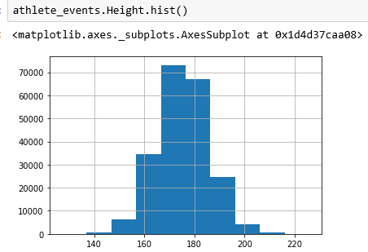
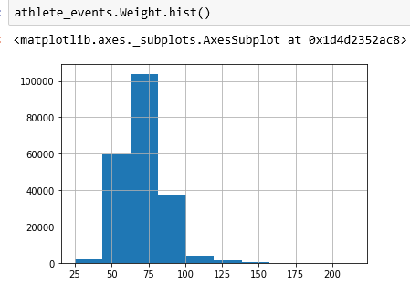
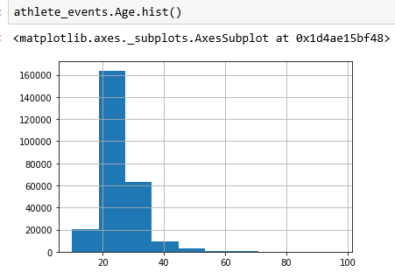

Slide 12
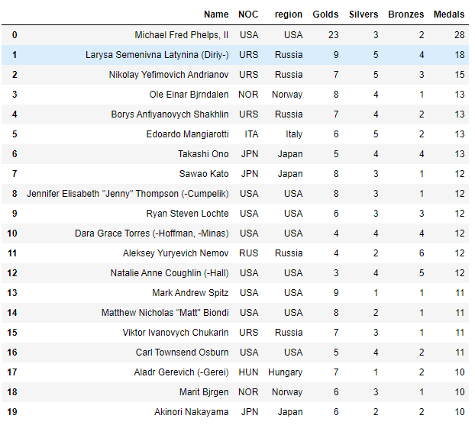
Top 20 Performers

Slide 13
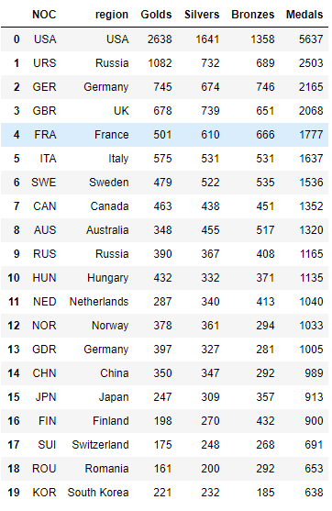
Top 20 Nations

Slide 14
Broader Exploration
We can group our dataset by nation and year, sorting by total medal count, to find the top performing Olympic teams of all-time. 15 of the top 20 Olympic teams came from the USA and Russia. After the USA dominated the 1904 Olympic Games, in which only 12 nations competed, the 1980 Russia and 1984 USA teams collected the most medals during the modern era. The USA led 66 nations in boycotting the 1980 Olympic Games, which were hosted by Moscow during the Cold War. In retaliation, the USSR led 14 nations in boycotting the 1984 Olympic Games held in Los Angeles. These back-to-back Olympic Games demonstrate the influence that these global superpowers wielded in shaping the outcome of the Olympic medal table. It is notable that Russia competed as EUN and now as RUS after the collapse of the Soviet Union (URS). This also coincided with the biennial staggering of the Summer and Winter Olympics. We realise that there were major geopolitical shifts and Olympic organisational changes.
We observed host nations significantly outperform visiting nations at the Olympic Games. The 25th percentile of host nations win more medals than the 75th percentile of visiting nations. Further, the four top-performing teams of all-time were host nations, so let’s keep host nation as a feature in our machine learning model.
An interesting find in the data is that even though height and weight is dependent on sex, the sports which have the highest/lowest average weight/heights are the same for both sexes. We even checked for average BMI. The sport with the highest average height is of course basketball with an average of 2m for men and 1m 87cm for women. The sport with the shortest athletes is Artistic Gymnastics with an average height of 1m 67cm for men and 1m 55cm for women. The sport with the highest BMI is weightlifting and the sport with the lowest is the Triathlon.

Slide 15
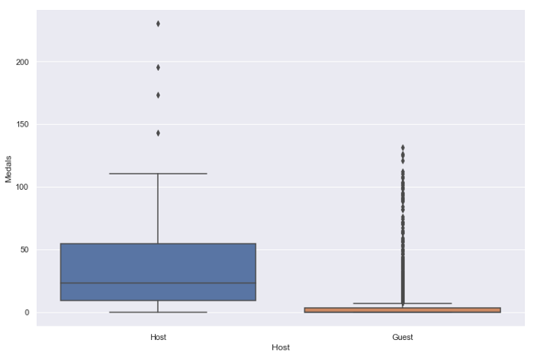
Medals: Host Vs Visiting(Guest)

Slide 16
Medal Prediction Tips
We have identified several features (athletes, events, athletes per event, summer games, outlier nations, host nation) to include in predicting the medal count of a nation at an individual Olympic Games.
We need to limit the training data to those records beginning with the Barcelona 1992 Olympic Games, since the era prior to the collapse of the Soviet Union might be significantly different. We do not need to scale our features because the sensitivity of our target variables will be incorporated into the coefficients of the features.
The target variable is the total medal count for each nation at an individual Olympic Games, but our dataset also contains the results for gold, silver and bronze medals. So instead of directly predicting the total medal count, let’s create three regression models to individually predict each kind of medal. We can then sum gold, silver and bronze medals to find the total medal count.
We would like our machine learning model to generalize to the Tokyo 2020 Olympic Games, so we should split the records of our data into training and test sets for model validation. This is typically performed with an 80-to-20 random split, but we can also perform a time-based split.
We can limit our feature nations to the 10 top-performing nations of all-time as well as Japan, the host nation of the Tokyo 2020 Olympic Games. We can now train each of our three regression models, obtaining equations that can be expressed by the coefficients of each feature term. Finally, we can use our trained models to predict the medal counts of previously unseen data.

Slide 17
Conclusion/Recommendation
The outcome of the data exploration of Olympic dataset is inline with the initial hypothesis we made.
The host-nations outperform at Olympic games against visiting nations.
High-performing athletes can win medal multiple times at an Olympic Games in various events, giving their nations an advantage.
We found the various interesting trends, patterns with respect to Age, Height, Weight, Sex (Gender).
We also identified the features for medal prediction for Tokyo 2020 games. Also we recommended some tips that would help medal predictions.

